Slide 1

Flutter

Slide 2
Bottom Navigation

Slide 3
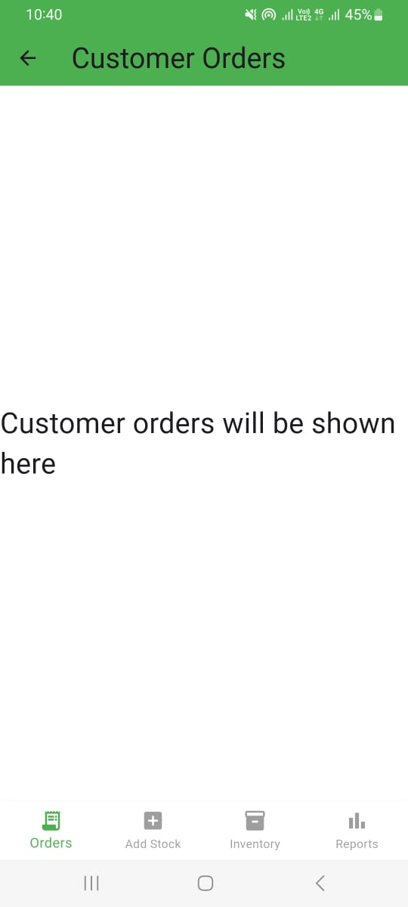
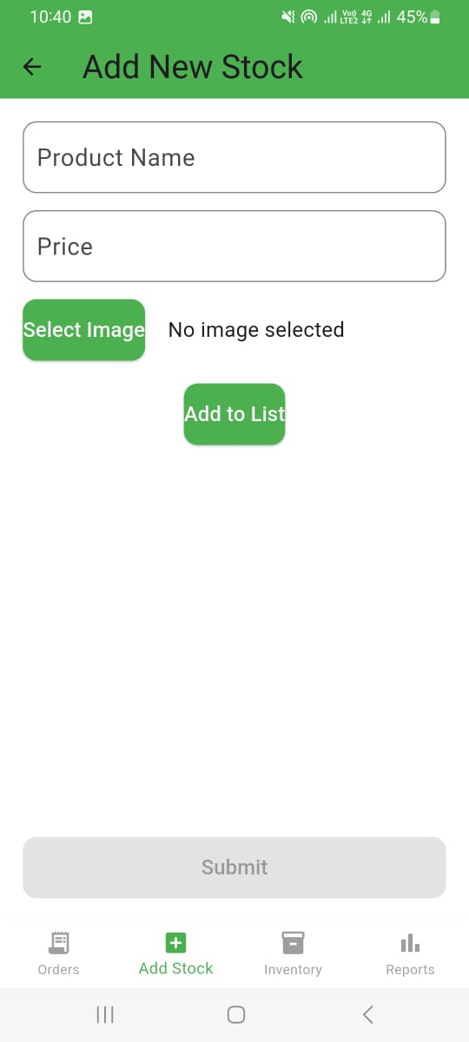
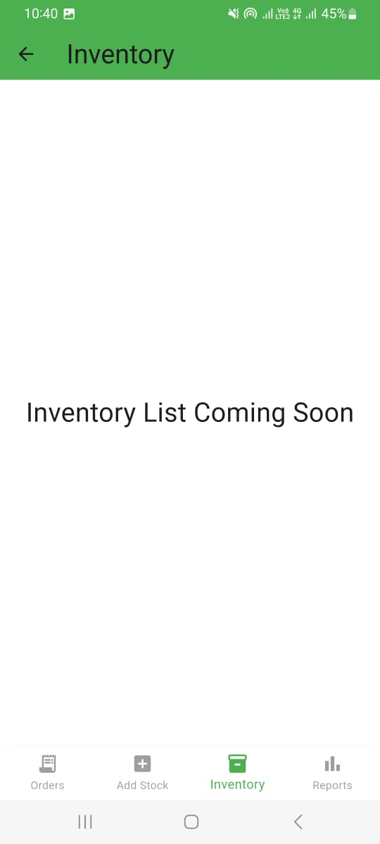
Bottom Navigation

Slide 4
Bottom Navigation
final List<Widget> screens = [
CustomerOrdersScreen(),
AddStockScreen(),
InventoryScreen(),
ReportScreen(),
];
items: [
BottomNavigationBarItem(
icon: Icon(Icons.receipt_long),
label: "Orders",
),
BottomNavigationBarItem(
icon: Icon(Icons.add_box_rounded),
label: "Add Stock",
),
BottomNavigationBarItem(
icon: Icon(Icons.inventory_2),
label: "Inventory",
),
BottomNavigationBarItem(
icon: Icon(Icons.bar_chart),
label: "Reports",
),
],
int selectedIndex = 0;
body: screens[selectedIndex],
bottomNavigationBar: BottomNavigationBar(
currentIndex: selectedIndex,
onTap: (index) {
setState(() {
selectedIndex = index;
});
},
)

